Slide 1
Lecture 5 Support Vector Machine (SVM)
CS582
Machine Learning: Getting Computers
to Program Themselves
“Discovering the Learning Dynamics of the Laws of Nature”
Dr. Emdad Khan
ekhan@mum.edu
Dept. of Computer Science
Maharishi University of Management
Nov, 2018

Slide 2
SVM Basics
Remember the Perceptron could not distinguish the 2 classes of 2D XOR.
However, Perceptron could distinguish the 2 classes of XOR when we added a new dimension (sort of increasing the VC Dimension).
We moved the data that we could not classify properly to the 3rd dimension so that we could linearly classify the data.
SVM (and other algorithms) use this insights.
The key problem is how to work out which new dimensions to use.

Slide 3
SVM Basics
Kernel Method helps us to find such dimensions as we will see soon.
SVM (introduced by Vapnik in 1992) is a popular ML algorithm. It provides impressive results on reasonably sized datasets.
SVM reformulates the classification problem in such a way that we can tell a good classifier from a bad one, even if they both give the same results on a particular dataset.
However, SVMs do not work well on large datasets since the computations do not scale up well with number of training examples.

Slide 4
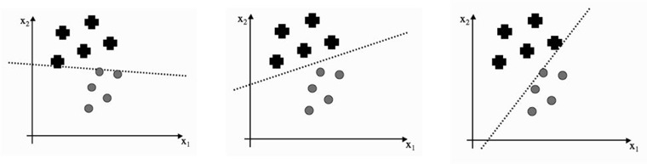
Optimal Separation
Can you tell which separation line is the best, and why?
What Algorithm can be used to find the best one?

Slide 5
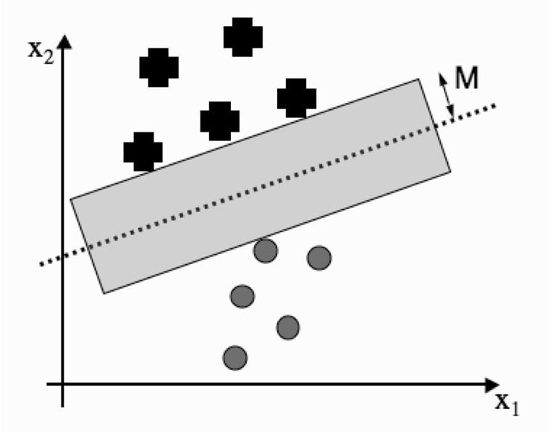
Margin and Support Vectors -1
One way is to measure the distance from the line (in perpendicular direction) before we hit a data point.
This distance is shown as M and is called Margin (Cylinder in 3D and hyper cylinder in higher dimension).
The data points in each class closest to the classification line is called Support vectors.

Slide 6
Margin and Support Vectors - 2
The classifier line can be written as
y = w · x + b where W is matrix and x is a vector.
Any x providing a value of +ve y will be above the line (classifying as ‘+’) and any value of x providing negative y, will be classified as ‘o’. But to include M, we should say any value of x providing y >= M is ‘+’ etc.
Pick a point x+ that lies on the ‘+’ class boundary line, so that wTx+ = M. This is a support vector.
We want to find the w and b that give us the biggest possible value of M.

Slide 7
Margin and Support Vectors - 4
Note that width of the margin is proportional to 1/‖w‖ when we make w a unit vector.
This tells us that making M as large as possible is the same as making w^{T}w as small as possible.
So we need to satisfy two problems simultaneously:
find a decision boundary that classifies well, while
also making w^{T}w as small as possible.

Slide 8
Margin and Support Vectors - 5
Mathematically we can say, minimize w^{T}w subject to some constraint that says that the data are well matched.
Now we need to work out what these constraints are - this is basically a constraint optimization problem.

Slide 9
A Constraint Optimization Problem -1
To find out what the constraints are, we first use -1 for one class and +1 for the other class.
So we can then write down ti x yi, that is, the target multiplied by the output, which will be positive if the two are the same and negative otherwise.
Our straight line equation require ti(w^{T}x + b) ≥ 1 to ensure correct classification.

Slide 10
A Constraint Optimization Problem - 2
So, the problem we need to solve can be formulated as

Slide 11
A Constraint Optimization Problem -3
We've put in a lots of efforts to write equation 8.1, but we don't know how to solve it.
Gradient descent would be difficult to enforce the constraints.
Fortunately, the problem is a quadratic problem and there is a solution for Quadratic Programming.
We are not deriving the details to make it simple. However, after formulating our problem to fit with quadratic programming and then solving, we get the necessary equations for W and bi (next slide)

Slide 12



Solving with Quadratic Programming
Z in equation 8.11 is a new data to be classified. Ns is total number of Support Vectors and Lamda i’s are Lagrange Multipliers.

Slide 13
Kernel and Kernel Trick - 1
Equations 8.8 to 8.11 are good SVM equations. However, these are good for linear problems only.
We need to address nonlinear problems as many applications are in that domain.
For this we need to use the Kernel Trick.

Slide 14
Kernel and Kernel Trick-2
Kernel Trick is similar to the way we solved the XOR problem in Perceptron by adding an extra dimension.
So, our final SVM algorithm uses the SVM equations, we have shown BUT somehow transform them in a way that can handle nonlinear problems.

Slide 15
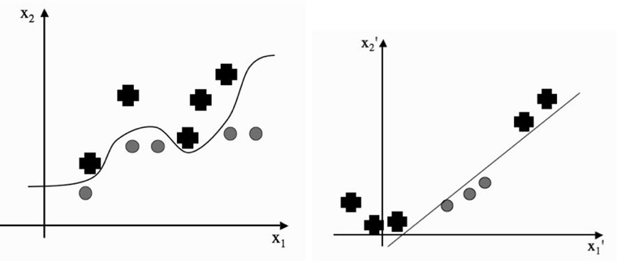
Kernel and Kernel Trick-3
By modifying the features (e.g. using a function f(x1^2,x1) to transform x1 to x1’, we hope to find spaces where the data are linearly separable e.g. in 2D this case. But it can be in higher dimension as well.

Slide 16

Kernel and Kernel Trick-4
Basically, we can assume that there is a new function that transforms our data into a different (especially in a higher dimensional space). The modified equation becomes:
Good news is that using some kernel K (next slide), we do not really need to compute Θ(xi)TΘ(xj), saving time as it is very compute intensive. We just need to pick a good Kernel K.

Slide 17
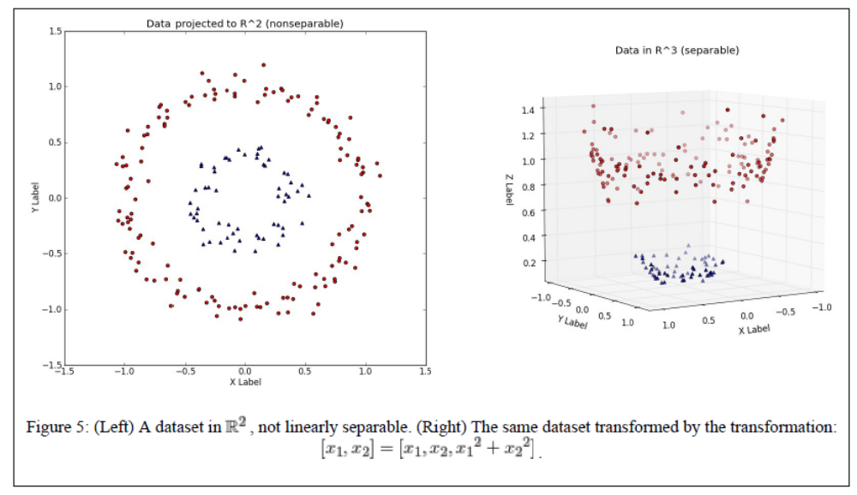
Kernel and Kernel Trick-5
Let’s use an example:

Slide 18
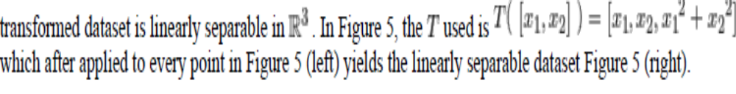
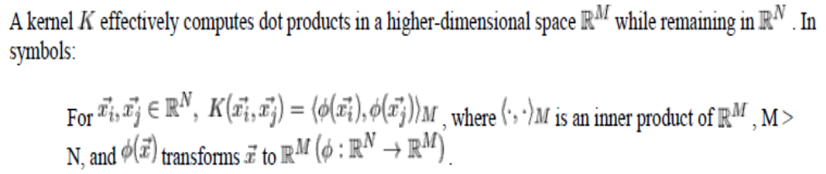
Kernel Function
Kernel Function
A Kernel Function basically achieves the same as shown above but without using Transformation T directly.

Slide 19
Some Good Kernels
8.19 for polynomials up to some degree s in the elements x_{k} of the input
8.20 is a sigmoid (as used in NN); 8.21 is RBF, also used in NN.

Slide 20
SVM Algorithm
Initialization – for the specified kernel, and kernel parameters, compute the kernel of distances between the datapoints
* the main work here is the computation K = XXT * for the linear kernel, return K, for the polynomial of degree d return (1/σ)K^d
* for the RBF kernel, compute K = exp(−(x − x′)2/2σ2)
Training – assemble the constraint set as matrices to solve:
– pass these matrices to the solver

Slide 21
SVM Algorithm
– identify the support vectors as those that are
within some specified distance of the closest
point and dispose of the rest of the training data
– compute b* using equation (8.10)
Classification – for the given test data z, use the support vectors to classify the data for the relevant kernel using:
* compute the inner product of the test data and the
support vectors
* perform the classification as
∑ni=1 λitiK(xi, z)+b*, returning either the label (hard classification) or the value (soft classification)

Slide 22
SVM Algorithm
For real implementation, we would need to do a bit more processing. The final equations become:

Slide 23
SVM Algorithm
The cvxopt quadratic program solver is cvxopt.solvers.qp(). This takes input cvxopt.solvers.qp (P, q, G, h, A, b) and then solves (x is the variable we are solving for, which is lambda for us)
Without going further details (as hopefully you got the basic idea), let’s look into the SVM algorithm in Python (next slide).

Slide 24
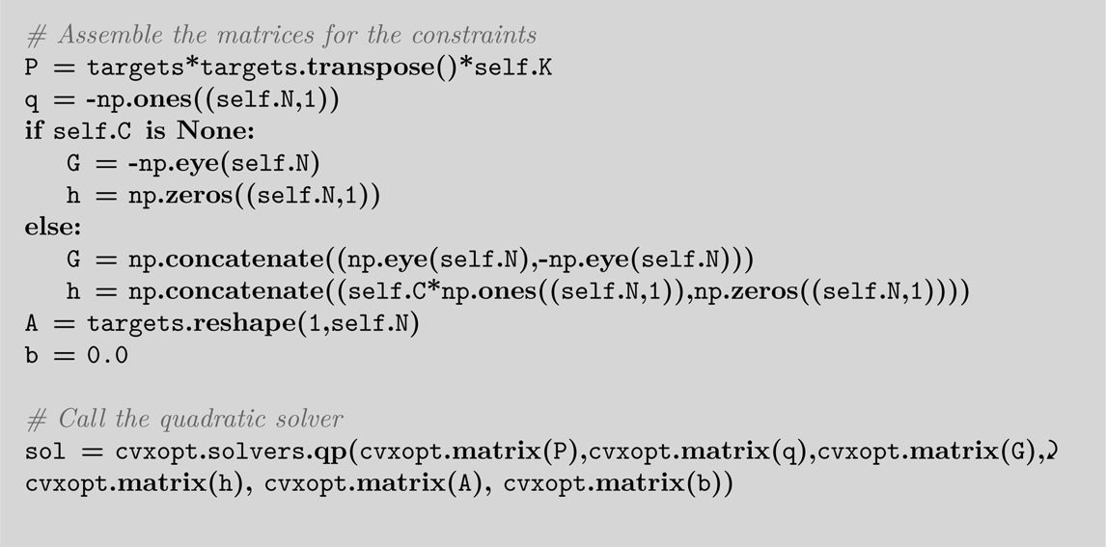
SVM Algorithm Using Python

Slide 25
Multi-Class Classification
SVM shown so far can only classify into 2 classes.
For the problem of N-class classification, train an SVM that learns to classify class one from all other classes, then another that classifies class two from all the others.
So for N-classes, we have N SVMs
This still leaves one problem: how do we decide which of these SVMs is the one that recognises the particular input?
The answer is to just choose the one that makes the strongest prediction. With some extra work, it can be improved to some extent.

Slide 26
Advantages of SVM
SVM provides Global Minima.
It is a Maximum Margin Classifier.
Once a boundary is established by the Support Vectors, most of the training data is redundant as the Support Vectors support the boundary.

Slide 27
Disadvantages of SVM
SVM shown so far can only classify into 2 classes.
Perhaps the biggest limitation of the support vector approach lies in choice of the kernel.
Second limitation is speed and size, both in training and testing.
The optimal design for multiclass SVM classifiers is a further area for research.
Large scale scalability is also an issue (there are some development in this area though).

Slide 28
Eigen Values and Eigen Vectors of a Matrix - Example
See the other document

